Slide 1
Homework 7 - Directions
For this homework you will be highlighting the datapath through the pipelined version of the RISC-V processor. I have provided as a review a solution for the jr instruction on the single cycle datapath, as well as a solution for jr on the pipelined version of the RISC-V processor.
Like Homework 6 for each instruction you are allowed to cut wires, add any new wires, add new connections to existing wires, and to add additional components that we have used in Logisim – aka, multiplexors, adders, shifters, demux, etc. See the example I provided for jr as an example. Don’t forget about the control signals, how should they be set? Does your instruction need new control signal(s)?
You can mark up and annotate each datapath any way that you want – on the computer, by hand, take pictures, etc. But your changes must be clear and easy to follow to receive full credit. On my sample I used different colors for each phase of the pipeline, and for my pipeline datapath and control signal changes: For the Instruction Fetch (IF) Phase For the Instruction Decode (ID) Phase For the Execute (EX) Phase For Memory (MEM) Phase
For the Register Writeback (WB) Phase For new components (MUX, Gates, ETC) For new data path lines For new control signals
HINT: This is the pipelined version of the processor – MAKE sure that everything flows through all stages of the pipeline as you formulate your solutions
#

Slide 2
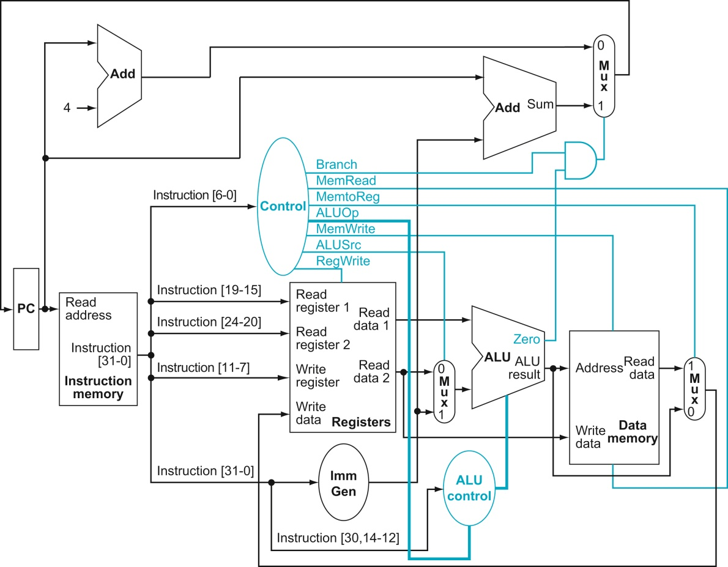















Q1: Jump Register jr Datapath Note jr = jalr x0, Rs,0
Note this is because its an I type instruction but write register is not a problem because it’s the zero x0 register
5
mux
1
Jump-Reg-Control
PC points to jr instruction
Instruction is fetched and decoded – Rs1 and Rs2 placed on register file,Rs2 is zero register. Immediate value hard coded to 0 Control signals established
Immediate value added to Rs1
ALU result is new PC addresss
New wire routes PC address up to new mux that places PC value on output of upper right mux which will be the next PC address (on next clock cycle)
1
x
0
x
+0010
0
1
Rs
1
1
2
4
0
3
x
1
Zero Register
+0010
This is to refresh your memory of the single cycle solution. The solution for the pipelined version is on the next slide
0
0

Slide 3
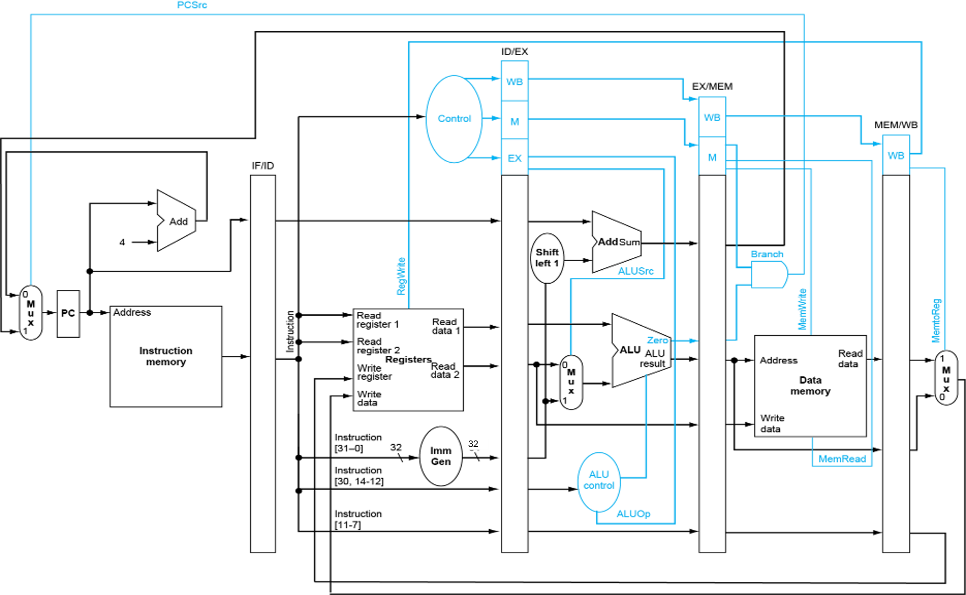
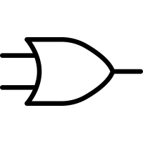























Q1: Jump Register jr Datapath jr = jalr x0, Rs,0
1
1
0
Updated logic to control PC address
New JR Control Signal
1
addr
New wire to route address back to the PC
addr
addr
0
1
0
x0
0
-
0
addr
0
Correct address for PC established here
x0
+
x0
x0
x0

Slide 4
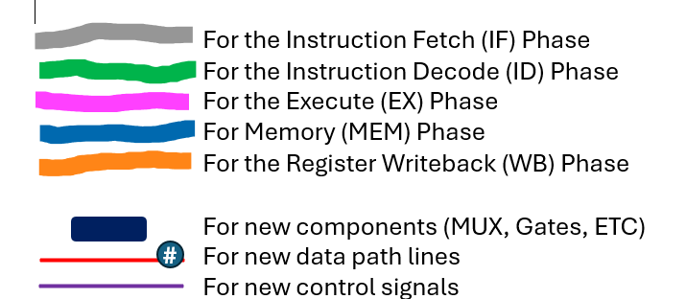















Q2: Store Word (sw) Datapath
0
rs1
0
rs1
1
rs1 + imm
1
rs2
imm
+
rs2
imm
0

Slide 5




























Q3: Jump Link jal Datapath
1
OR
1
Added new control signal and mux to choose between pc+4 and read data 1 in execute phase.
Added another control signal to choose between branch or jump in memory phase.
pc + imm
1
1
1
0
Zero register
X
pc + imm
0
0
rd
+
Zero register + (pc + 4)
Zero register + (pc + 4)
jal rd, imm # rd = pc + 4; pc += imm
rd
rd
rd

Slide 6




















Q4: Load Upper Immediate lui Datapath
0
Zero register
1
Zero register
0
1
Imm << 12
0
rd
Added new control signal, shifter and mux to choose between shifting the immediate by 12 bits in the execute phase of the pipeline.
Imm << 12
Imm << 12
+
imm
1
0
lui rd, imm # rd = imm << 12
Shift left 12
1
0
rd
rd
rd
rd

